Slide 1
Introductory Discussion on Design Pattern

Slide 2
What is a software design pattern?
A standard solution to a common programming problem
  a design or implementation structure that achieves a particular purpose
  a high-level programming idiom
It is a description or template for how to solve a problem that can be used in many different situations
A technique for making code more flexible or efficient
  reduce coupling among program components
  reduce memory overhead
Shorthand for describing program design
  a description of connections among program components

Slide 3

Gang of Four
23 design patterns
Three categories:
  Creational
  Structural
  Behavioral

Slide 4
Creational Patterns
How objects are instantiated
Five creational patterns
  Factory method
  Abstract factory
  Builder
  Prototype
  Singleton

Slide 5
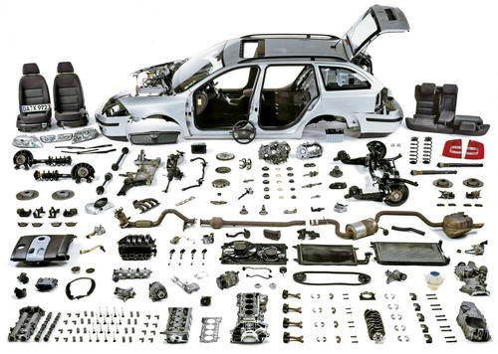
Structural Patterns
How objects / classes can be combined
Seven structural patterns
  Adapter
  Bridge
  Composite
  Decorator
  Façade
  Flyweight
  Proxy

Slide 6

Behavioral Patterns
How object communicate
11 behavioral patterns
  Interpreter
  Template Method
  Chain of Responsibility
  Command
  Iterator
  Mediator
  Memento
  Observer
  State
  Strategy
  Visitor

Slide 7
Essential Elements of a Design Pattern
Intent | Design goals of a pattern
Problem | Describes when to apply the pattern Explains the problem and its context
Solution | Elements that make up the design Relationships and collaborations among the elements
Consequences | Benefits Trade-offs

Slide 8
Why needed
Requirements always change. Requirements change for a very simple set of reasons:
    • The users’ view of their needs change as a result of their discussions with developers and from seeing new possibilities for the software.
    • The developers’ view of the users’ problem domain changes as they develop software to automate it and thus become more familiar with it.
    • The environment in which the software is being developed changes.

Slide 9
Why needed
Rather than complaining about changing requirements, we should change the development process so that we can address change more effectively.
The design of software should be able to accommodate many possible changes.
Design patterns help to write codes that can accommodate changes easily.

Slide 10
Reasons to study Design Pattern
Reuse existing, high-quality solutions to commonly recurring problems.
Establish common terminology to improve communications within teams.
Shift the level of thinking to a higher perspective.
Decide whether I have the right design, not just one that works.
Improve individual learning and team learning.
Improve the modifiability of code.
Facilitate adoption of improved design alternatives, even when patterns are not used explicitly.
Discover alternatives to large inheritance hierarchies.

